Slide 1
OTA Functional Safety

Slide 2
Problem Statement
Per existing HARA analysis, the A/B OTA Feature is ASIL-D
ASIL-D Decomposition between ECG and Target ECUs was applied successfully to the majority of the OTA FSRs but not all
FSRs which are still ASIL-D:
OTA Feature Evaluates Activation Success
OTA Feature Evaluates Roll Back Success
OTA Feature Commands Rollback Upon Unsuccessful Activation
The P702 ECG acting as a single Software Update Manager is an ASIL-B ECU (Design Constraint)
Cross functional “task force” re-evaluated the original HARA and concluded that the ASIL rating of the activation and roll back processes must remain ASIL D.

Slide 3
Risk Assessment
The ASIL-D risk is limited to a very narrow use case
All of the following conditions must be met for the risk to be present
The MMOTA update contains an ASIL C/D function
The MMOTA update is Coordinated between two ECUs and is safety related
All ECUs need to get the OTA update. If one ECU was updated but not the others then it may result in unsafe state at the vehicle level
SW update failure cannot be detected by other ECUs involved in the MMOTA
Two failures need to occur (See Backup for failure scenarios)
This risk is also present in the existing ECU update by service personnel

Slide 4
Job-1 Recommendation: ASIL Reduction Factor from D to B
ASIL Reduction Factors applied in the OTA HARA/FSC
Condition:
Post production, coordinated and safety dependent ASIL C/D SW updates
Primary:
Add a requirement for SW updates meeting the Condition to be either backward compatible and/or SW version mismatch is detectable and will result in a vehicle level Safe State
Secondary:
Implement a controlled Deviation process for modules that require fundamental changes to HW/SW design to meet the Primary that can’t be implemented for MY21 P702

Slide 5
Next Steps
Primary:
Task-1: Add the requirement in FSMS/FEDE for all modules. Prioritize ASIL C/D modules for approval
Responsibility: CVP&P
Secondary:
Task-2: Collect data for the average rate of high safety critical, dependent and coordinated SW updates during typical vehicle warranty period (= Historical Average) in the last 5 years.
In case this info in not available or is hard to determine it can be replaced by a conservative estimated value (= Historical Estimate) approved by management
Responsibility: EESE Systems with support from CVP&P
Task-3: Implement OTA signoff process for ASIL C/D coordinated SW updates
Next Slide
Responsibility: CVP&P
Long Term Solution – OTA 2.0:
The OTA research team to investigate feasibility of redesigning the OTA feature to be QM
FuSa technology recommended: SOTIF (Safety of the Intended Function)

Slide 6
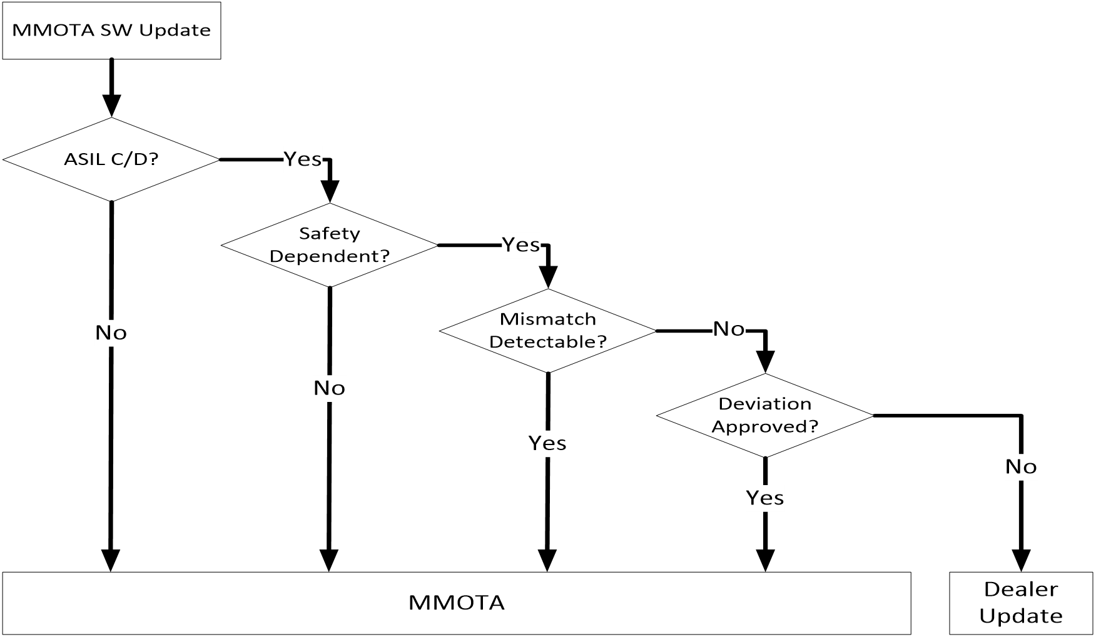
Deviations
Deviations:
Approved by Chief Engineer or Technical FuSa Leader only if MMOTA SW updates that don’t support backwards compatibility/fault detection:
Don’t result in a unsafe vehicle state
Don’t result in non-compliance to regulatory (FMVSS, OBD, etc..) requirements
Don’t exceed the Historical Average/Estimate

Slide 7
Backup

Slide 8
Alternate Proposal– Decompose between ECG and 2nd OTA Manager
Concept:
Dual independent OTA Managers. Each is developed to a minimum of ASIL-B according to ISO-26262 requirements for ASIL Decomposition
The decisions affecting part number validation and ignition inhibit/de-inhibit during OTA activation and rollback will be shared by the two OTA Mangers
Candidates are: ECG and PCM/ECM/HPCM
Pro:
Will meet the ASIL-D integrity target
Con:
Additional feature design and implementation complexity
Will require high communications protection integrity for the information shared between the two OTA Managers (AUROSAR E2E, HASH, etc..)

Slide 9
Functional Safety Scenario 1
Initial State: 1A & 1B is a safe vehicle state
Target State: 1B & 2B is a safe vehicle state
For FuSa independent MMOTA
Error states (1A, 2B) or (1B, 2A) are safe vehicle states
For FuSa dependent MMOTA
Error states (1A, 2B) or (1B, 2A) are potentially unsafe vehicle states
Two Point Failure:
1. ECU 1 failed to update
2. ECG failed the do activation check properly and sent Drive= OK instead of commanding ECU 2 to Rollback
These two failures are independent

Slide 10
Functional Safety Scenario 2
Two Point Failure:
ECG sends Rollback command to one ECU and not to the others resulting in mismatch SW versions
ECG fails the SW version check after the Rollback
The two failures maybe not be fully independent since there is a possibility of a common mode failure in the ECG that affects both.
Risk can be mitigated if single Rollback command is sent to all ECUs (or at least ASIL C/D ECUs)

Slide 11
All Options Considered
Option | Advantages | Disadvantages
Decompose ASIL D between ECG and ASIL C/D Target ECUs (Target ECUs must be backwards compatible or able to detect failure related to software mismatch) | Meets all Functional Safety goals and only impacts ASIL C/D modules | May require software changes to ASIL C/D modules
Decompose ASIL D between ECG and 2nd OTA Activation Manager. 2nd OTA Manager must be ASIL B or above. (Two OTA managers must check part numbers and agree on rollback) | Meets all Functional Safety goals and only impacts one other ECU | Additional design complexity. Requires high communication protection integrity between the two OTA managers (Autosar E2E, HASH, etc)
If Coordinated Software Update between ASIL C/D modules is safety dependent and not backwards compatible / cannot detect failure, no MMOTA | Meets all Functional Safety goals and does not impact any ECG software | Limited number of Software Updates will not be allowed via OTA (dealership update required).
Redesign ECG to be ASIL D | Meets all Functional Safety goals and only impacts ECG | Not Feasible – no ASIL D chipset currently available capable of performing ECG functions.

